Slide 1
COVID-19
EMS Education
McLean County Area EMS
3/12/2020

Slide 2
EMS Resources
The most up to date information can be found at: https://www.cdc.gov/coronavirus/2019-ncov/hcp/guidance-for-ems.html
Always use the CDC as your main source for information

Slide 3
What is COVID-19
A novel type of coronavirus
Not previously identified
Not the same as other human coronavirus that have spread
Potentially sourced from a Bat in a meat market in China
This is not a cold or the flu, this is a completely different virus
No vaccine is available

Slide 4
How it spreads
It is believed to spread through person-to-person (typically within 6 feet)
Spread through respiratory droplets
May be spread through airborne droplets
May live on surfaces for several days
May spread prior to symptoms showing

Slide 5
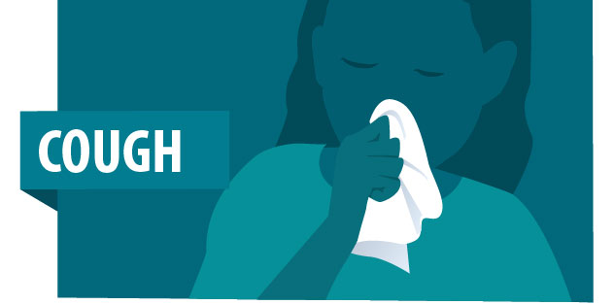
Symptoms
Respiratory illness
Fever
Cough
Difficulty breathing
Fatigue
***GI symptoms have been noted, but the prevalence is unknown right now

Slide 6
Incubation Period
2-14 days for incubation
Warm weather and temperature may not slow spread

Slide 7
Data
Most people have minor to mild symptoms and do not require additional treatments or hospitalization
It is suggested around 16% of cases require hospitalization.
Those at greatest risk are above the age of 60 with the comorbidities
Heart Disease
Diabetes
Lung Disease
Fatality rate is around 2.5%. This is approximately 20x higher than the flu
Rate is higher for those who are older and have associated comorbidities

Slide 8
EMS Dispatch Info
Currently all our dispatch centers are preforming screening for potential COVID-19 patients
Dispatch will notify of potential case in call notes
Rural agencies will be asked to contact dispatch once en-route
Potential positives should change how many people enter a residence. Additional PPE precautions should be taken
Positive call responses do not guarantee COVID-19, providers should continue to preform a full assessment/questioning on each patient.

Slide 9
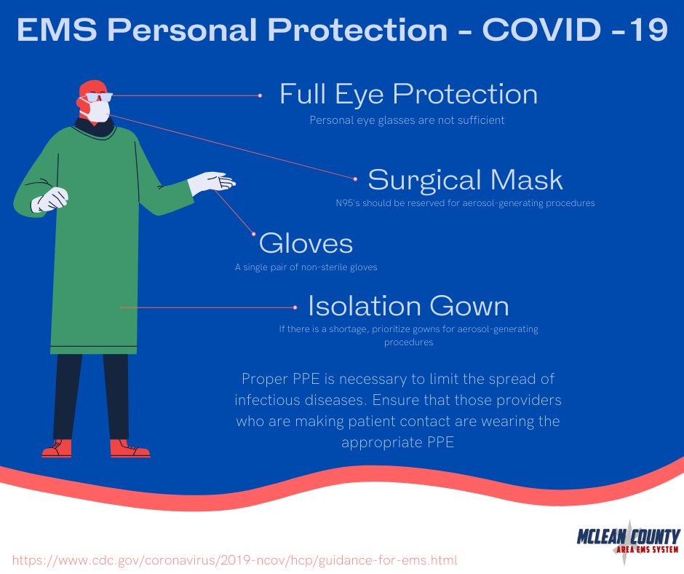
EMS PPE
For patients with suspected COVID-19:
Eye Protection, Gowns, Gloves
Surgical Mask
If performing aerosol-generating procedures, use a N95 mask
Reuse of N95s may be appropriate, follow the N95 re-use flowchart (separate)

Slide 10
EMS Assessment
Providers should ask the following questions:
Symptom history
Contact with anyone with flu like symptoms
Contact with anyone who has tested positive for COVID-19
Any patient who has symptoms history should be considered for potential COVID-19. Providers should have a high index of suspicion.

Slide 11
EMS Assessment
EMS providers should limit the amount of providers entering a scene with a person with symptoms
Ideally, we would limit to the minimum necessary for safety and we should start all assessments at least 6 feet away from the patient
We should minimize family contact as well

Slide 12
EMS Treatment
Treatment will be mainly supportive care
Ensure patients ABC’s are addressed
Mask should be placed on patient, O2 should be applied if needed. Avoid use of Solumedrol.

Slide 13
EMS Transport
Limited personnel should be in patient compartment during transport
The front of the cab should be isolated from the patient compartment
Ideally the driver should not have any patient contact at all.
Notification should be made to the receiving hospital as soon as possible
Upon arrival, EMS should remain in ambulance and contact the receiving hospital for further guidance on where to move the patient.
Patient movement in the hospital should be limited
The drive should remain in the cab if possible and not have patient contact if possible
Family members should not ride with the patient. Ideally, family members should remain at home. Some hospitals have limited visitor policies and may not allow family to enter.
Ensure exhaust fans are running and both drive and patient compartments should be on non-recirculated modes

Slide 14
EMS Documentation
Should be done after PPE is removed and proper hand hygiene completed
EMS documentation should include a list of all personnel and public safety providers that had any contact with the patient.

Slide 15
EMS Decon
Once patient is out of the ambulance, if possible, leave back doors open
Clean wearing disposable gloves and gown. A face shield or facemask and goggles should also be worn.
Pre-clean the area with disinfectants (Bleach wipes, commercial clearers) and then follow up with a EPA-approved emerging viral pathogen claim against SARS-CoV-2. Follow manufactures instructions.
If no EPA-registered product is available, you may use one with a label that claims is effective against human coronavirus
All surfaces, equipment and materials (including front of the cab) should be disinfected
All items may be disposed in bio-hazard bags.
Avoid shaking linens out

Slide 16
EMS Follow Up
EMS should report possible contact with their supervisors/chain of command
EMS providers should be looking for development of any symptoms
EMS System should be notified to assist with further guidance and potential self quarantines

Slide 17
EMS Re-stock
EMS should restock as much as possible using their own supply
OSF/ABMC will replace 1:1 on emergent basis
Please ensure supplies/PPE are be utilized appropriately, limit unnecessary use of these supplies
Agencies running low on PPE should contact the EMS office for assistance

Slide 18
Other Information
WASH YOUR HANDS!!!!
Stay home if you are sick
Fire/EMS agencies should begin preparing for staff shortages
Fire/EMS agencies should practice donning/doffing processes
Agencies should take inventory of supplies and monitor them closely
Please educate your providers so they have the most up-to-date information
Agencies should screen employees throughout shift for illness

Slide 19
Future State
As situation evolves changes may be made to appropriately address overuse of the EMS system
Please review CDC recommendations frequently
Please be on the look out for future information from the EMS System
As always, please call the office if you have any further questions

